Slide 1
MIE429 Final Presentation
Applying ML to Otitis Media
Diagnosis & Image Capture
Capstone Group 12 | Remmie Health
Thursday, December 8th, 2022
Notes:
Presenter: Markus
Good evening teaching staff, classmates, and guests.
My name is Markus, and with me is (list members in order).
We’re excited to present our Capstone Project, applying machine learning to Otitis Media Daignosis and otoscope image capturing. We worked with Remmie-Health, a Seattle-based, telehealth company.

Slide 2
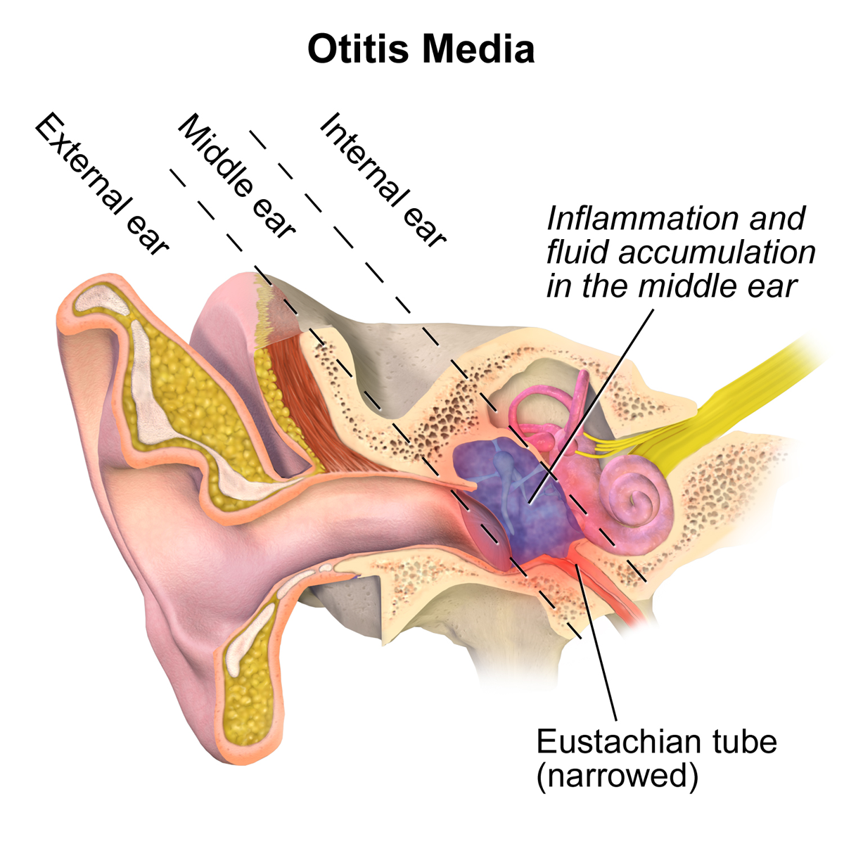



Background
Otitis Media (OM): Inflammation of the Middle Ear
Permanent Hearing Loss
Factors Limiting Treatment
Requires Visual Examination
BruceBlaus. Otitis Media. (Nov. 12, 2015). Accessed: Oct. 30, 2022. [Online Image]. Available: https://commons.wikimedia.org/wiki/File:Otitis_Media.png
Notes:
Presenter: Markus
Markus
Middle Ear infections, clinically known as Otitis Media (OM), are globally one of the most common childhood ailments.
Symptoms include fever, ear pain, and hearing loss.
Unfortunately, socioeconomic factors and practitioner availability limit access to treatment for this common illness.

Slide 3
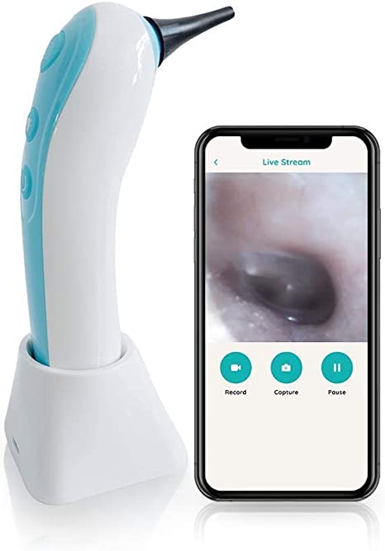
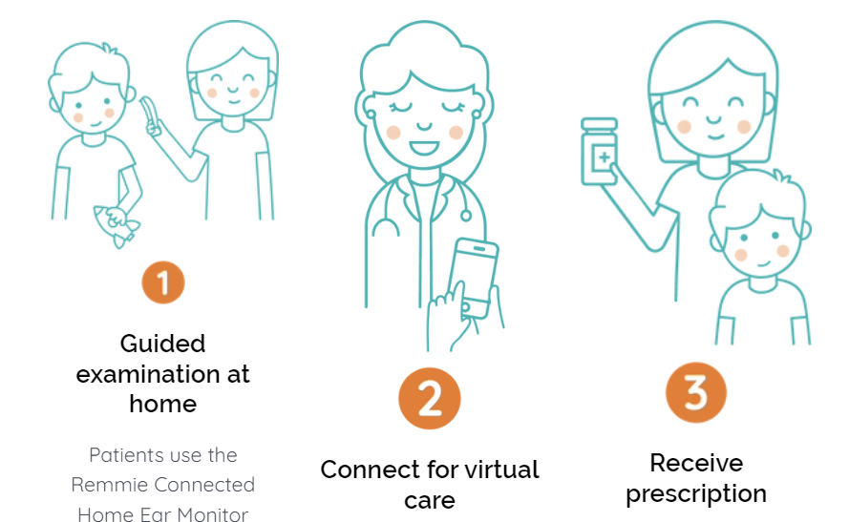

Meet Remmie
Remmie Health, 31-Oct-2022. [Online]. Available: https://www.remmiehealth.com/. [Accessed: 08-Dec-2022].
Notes:
Presenter: Markus
Markus
This is where our partner, Remmie, steps in. They offers a hardware-software ear monitoring solution for home use.
One product Remmie currently offers is their FDA approved home otoscope.
With this product, users can capture an image of their potentially infected ear, nose, or throat, and receive 24/7 evaluation from a doctor through their app’s telemedicine service

Slide 4
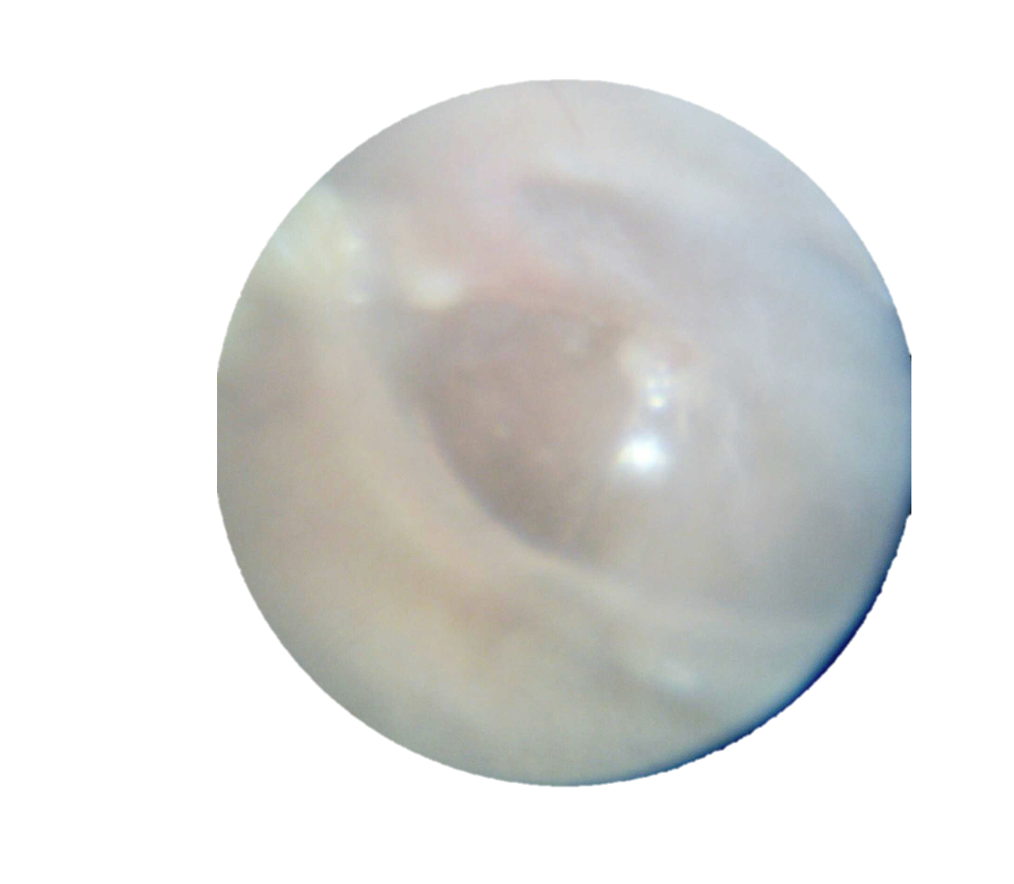
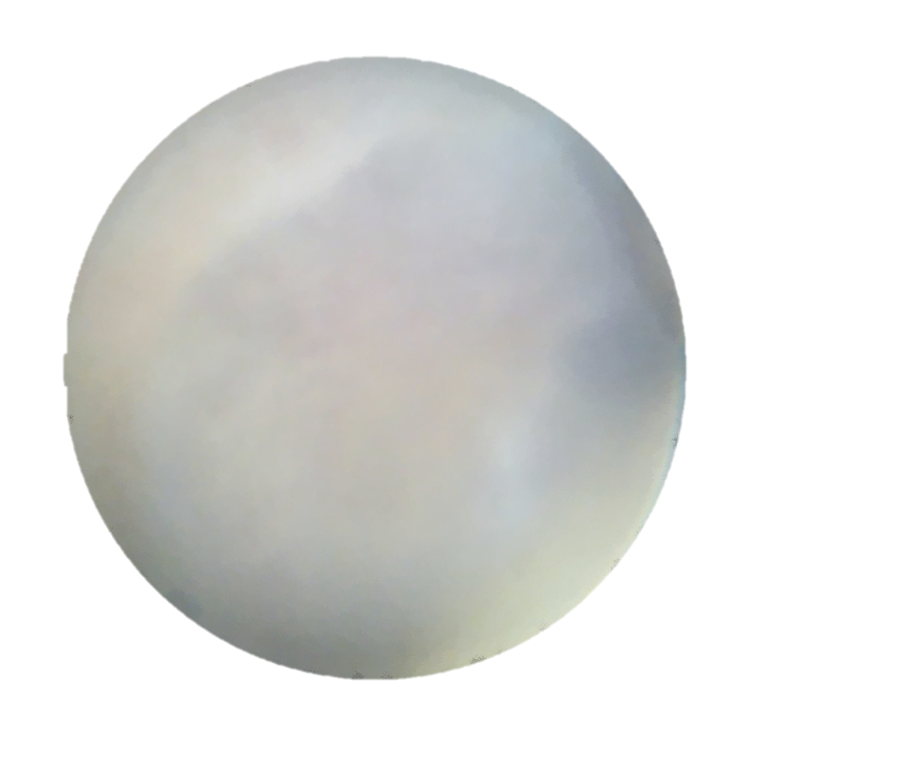
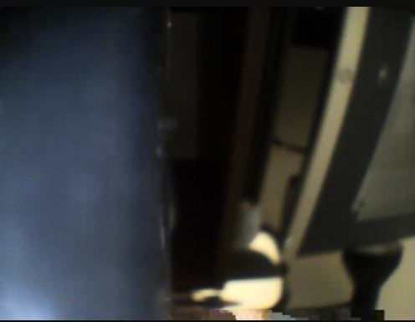

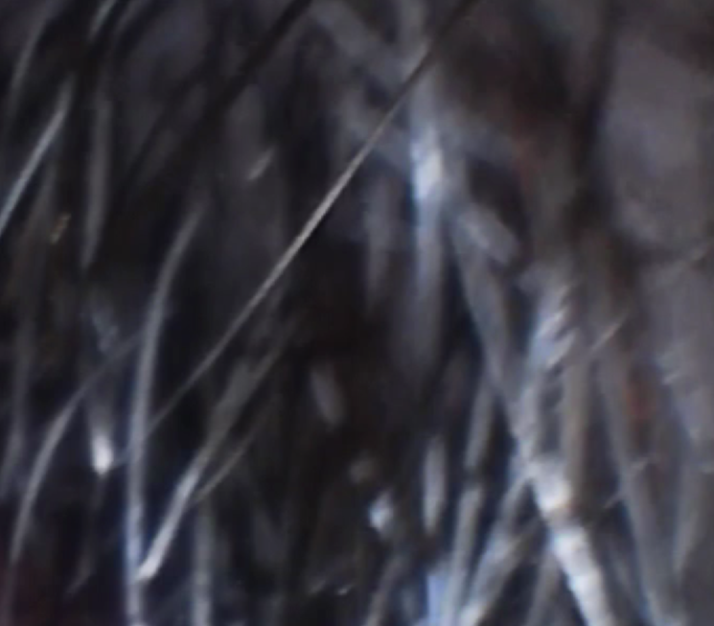

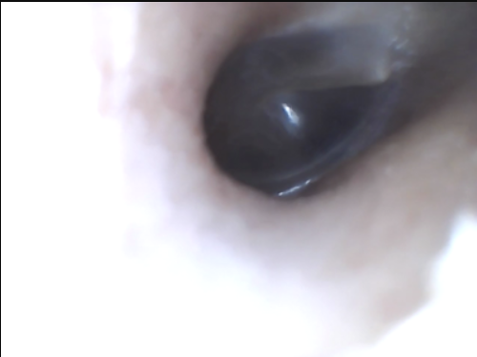


The Problem
Images Need Cleaning
Unsuitable for Diagnosis
Lack of Screening Tool
Notes:
Presenter: Markus
Markus
Unfortunately, using an otoscope can be tricky for new users, resulting in images that are uncentered or blurry.
These are not suitable for diagnosis, and requires back-and-forth communication with a doctor to resolve.
Remmie has also expressed interest in providing an AI-powered screening tool to help prioritize users with suspected OM.

Slide 5


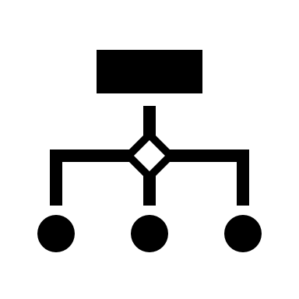
Our Goals
Data Processing
Object Detection
Diagnostic Classification
Notes:
Presenter: Markus
We determined 3 main objectives.
Process, label, and clean the images of eardrums.
Develop an object detection model to locate landmarks of the ear, which can be used to centre and rotate the image.
Develop a binary ML classifier that can predict if a person has OM from an image of their ear

Slide 6
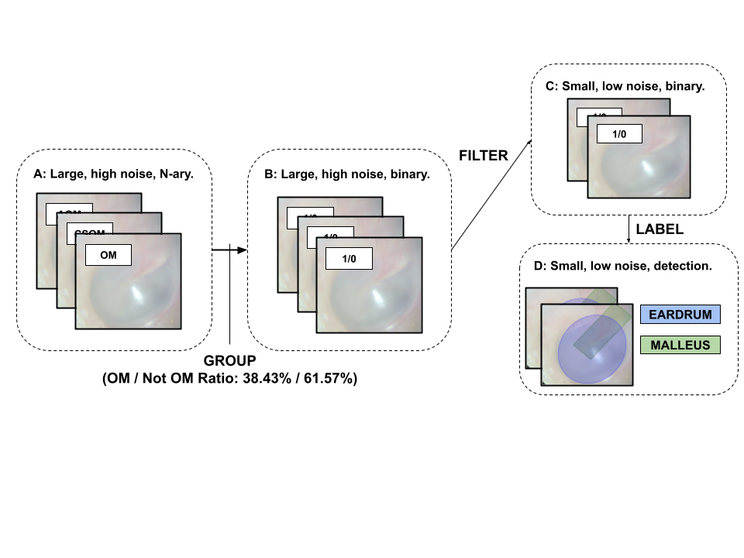
Datasets
(OM / Not OM Ratio:
40% / 60%)
3008
180
Taken by diagnosing doctors using otoscopes retrofitted with cameras, NOT with Remmie’s product or by their clients.
Notes:
Presenter: Tian
Remmie initially provided us with a dataset of 3008 images with 14 classes representing different ear conditions.
Since our task is to classify OM, we binarized the dataset into two classes, OM and not OM. This is our dataset B.
As you will see, we also created datasets C and D.

Slide 7
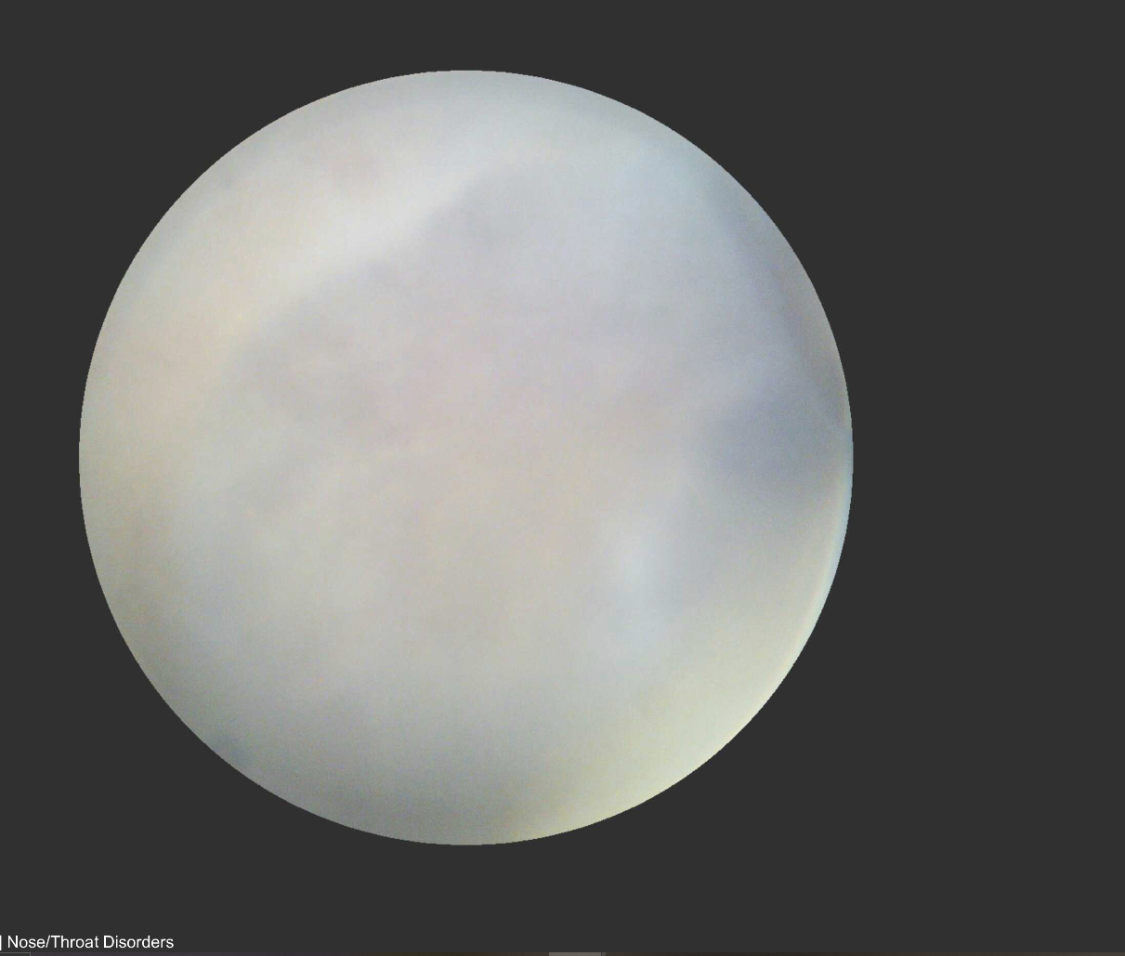
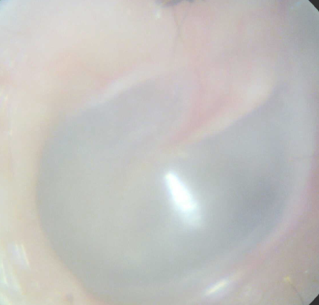
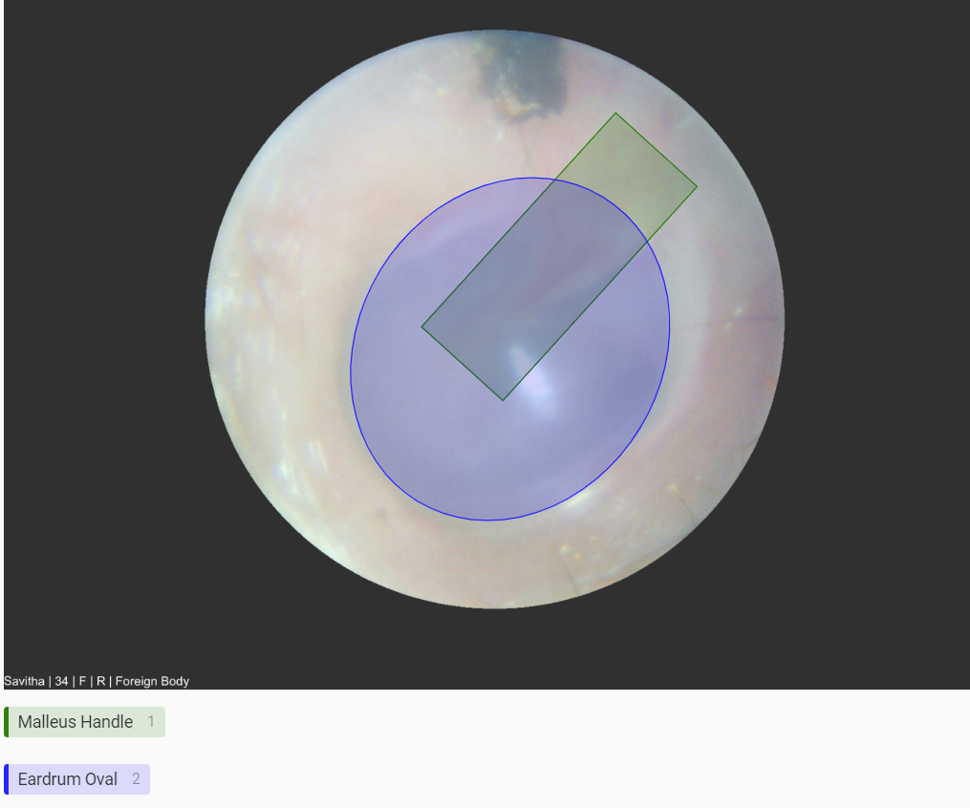
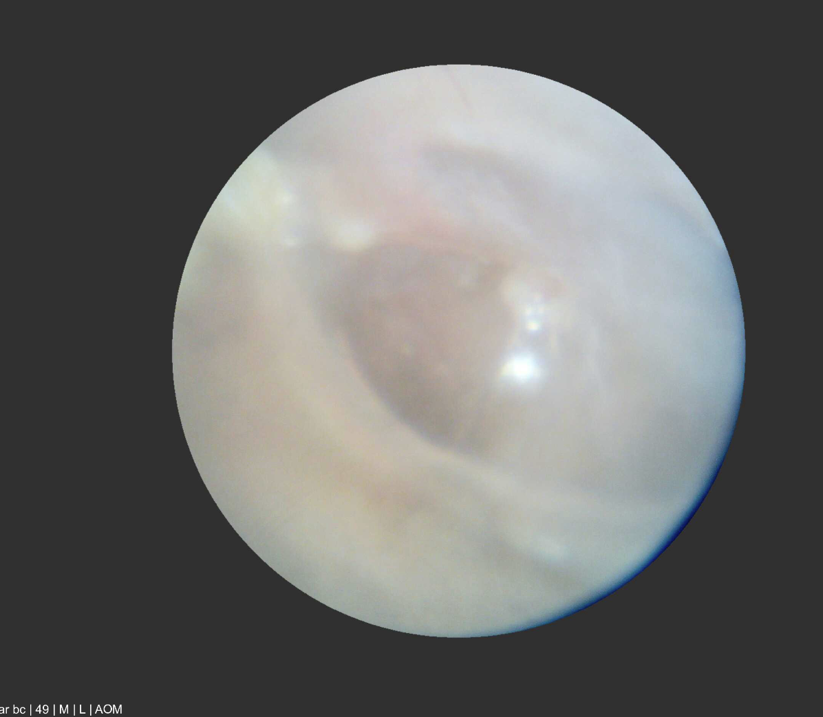

Data Processing
Group
Filter
Label
Dataset B
Dataset C
Dataset D
/
Not OM
These are the visual landmarks needed for object detection!
OM
Notes:
Presenter: Tian
Though a discussion with Remmie's medical expert, we realized that dataset A & B are too blurry to be useful.
Therefore, we filtered dataset B to construct a much smaller but higher quality dataset. This is our dataset C.
Meanwhile, we labelled dataset C of important features. This is our dataset D.

Slide 8
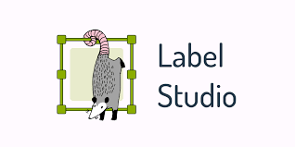
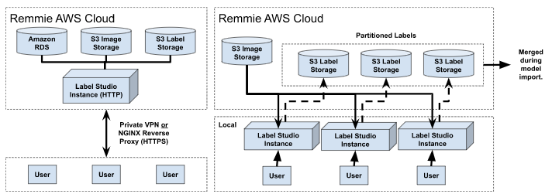
Labelling Infrastructure
Ideal Setup
Our Workaround
Notes:
Presenter: Tian
To label the data, we used an open source software, Label Studio.
Ideally, we should set up one Label Studio centrally on Remmie's server.
But due to infrastructure and time constraints, we used a workaround, which is to run individual LS instances on our computers.

Slide 9
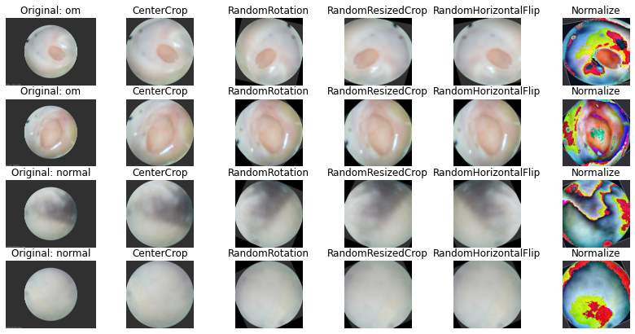
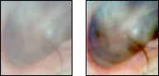
Image Processing
Original
Center Crop
Rotate
Resize Crop
Flip
Normalize
Colour Correction
Training Augments
Notes:
Presenter: Tian
To improve image quality, we employed several data augmentation methods, which are also used in past studies, including center crop, random rotate, random resize & crop, and random horizontal flip.
We also applied contrast correction to the images.

Slide 10
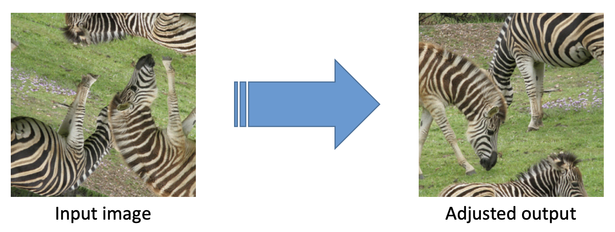
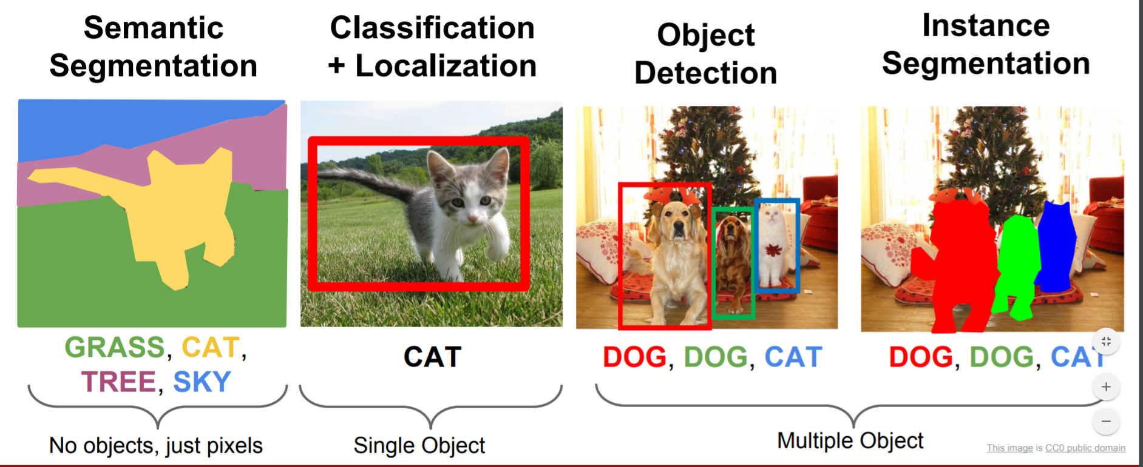
Prior Work
Object Detection
Our Basis
Alternative Approaches
P. Fischer, A. Dosovitskiy and T. Brox, “Image Orientation Estimation with Convolutional Networks,” University of Freiburg, 2015. [Online]. Available: https://lmb.informatik.uni-freiburg.de/Publications/2015/FDB15/image_orientation.pdf. [Accessed: 4-Dec-2022].
Notes:
Presenter: Jay
Late in the project, after speaking with Remmie, we realized our data may not be feasible for diagnosis.
After finding previous work discussing how classifiers could be repurposed for regression, we decided to pursue this as a proof of concept for feature recognition.
To disclaim, we didn’t have time for a full literature review – and re-doing this, we’d probably use object-detection or segmentation as our basis.

Slide 11
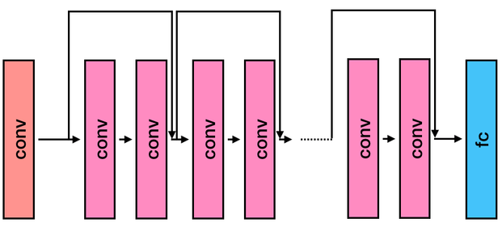
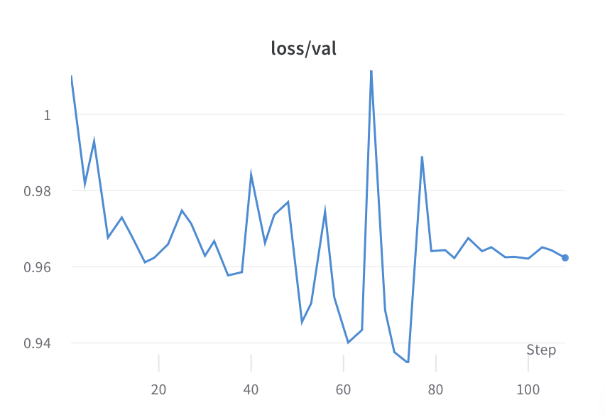
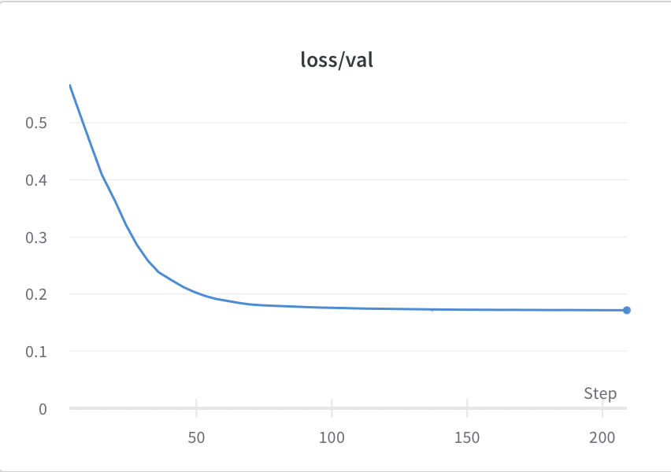
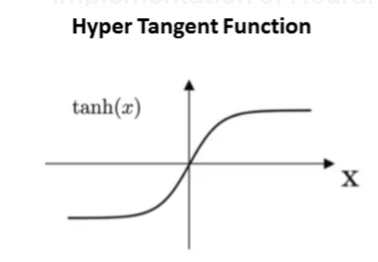
Design Decisions
Object Detection
CNN
ResNet50
CNN Backbone
Training Loss Curves
Output Activation
Notes:
Presenter: Jay
We experimented with major parts of the architecture.
One decision included which CNN backbone to use. We considered a custom network, resulting in the left curve, and ResNet, resulting in the right one.
Naturally, we chose ResNet.
Further-more our output has a range of 0-1, and as such, a sigmoidal activation seemed reasonable, but required validation due to the vanishing gradient problem

Slide 12
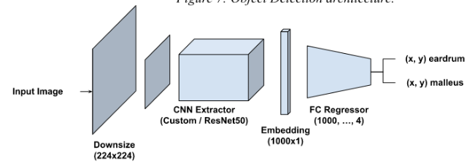
Final Architecture
Object Detection
Notes:
Presenter: Jay
This represents our final architecture.
We settled on a ResNet50 backbone, followed by a fully-connected regressor.
As our prediction, we output 4 floats, interpreted as a pair of 2D coordinates – one for the eardrum, and the other, the malleus.
Ultimately, we found that sigmoidal output activation was not effective.
We applied standard ResNet pre-processing to our inputs.

Slide 13
Quantitative
Model | Mean Percent Distance (MPD)
 | Malleus | Eardrum
rich-smoke-24 | 0.247 | 0.159
summer-snowball-25 | 0.246 | 0.161
lemon-darkness-42 | 0.290 | 0.218
toasty-disco-27 | 0.240 | 0.160
fresh-frost-45 | 0.247 | 0.159
Object Detection
1
~0.5
1
Notes:
Presenter: Jay
Wmeasured the performance of a given model via the distance ground truth and predictions, on a unit square.
For reference, two randomly chosen points exhibit a distance of 0.5, which forms our baseline.
On the right, we see a few examples of models, varying hyperparameters, with names generated by our tracking tool.
Of these runs, we selected summer-snowball-25, but further analysis is required.

Slide 14
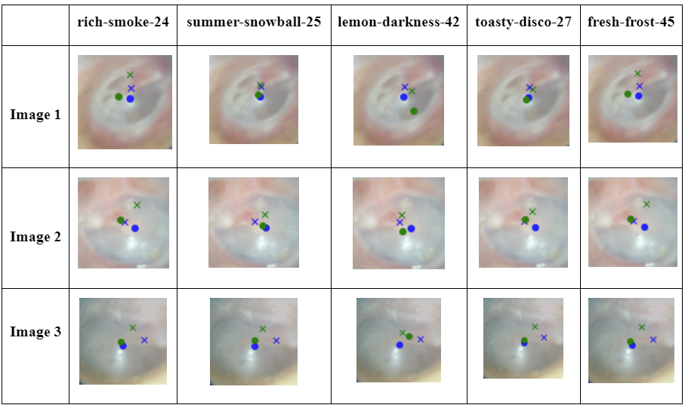
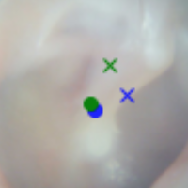
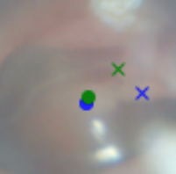
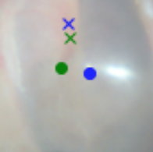
Qualitative
Object Detection
⨉ Actual Malleus
• Actual Eardrum
⨉ Predicted Malleus
• Predicted Eardrum
Notes:
Presenter: Jay
Here, we see predictions from this model, across a few images in our test set.
On the left, we see an image where both the eardrum, marked with circles, and the malleus, marked with crosses, were detected with significant accuracy.
Note the image on the right, which demonstrates a robustness to rotation. This does highlight some subjectivity, which will be discussed further down.

Slide 15
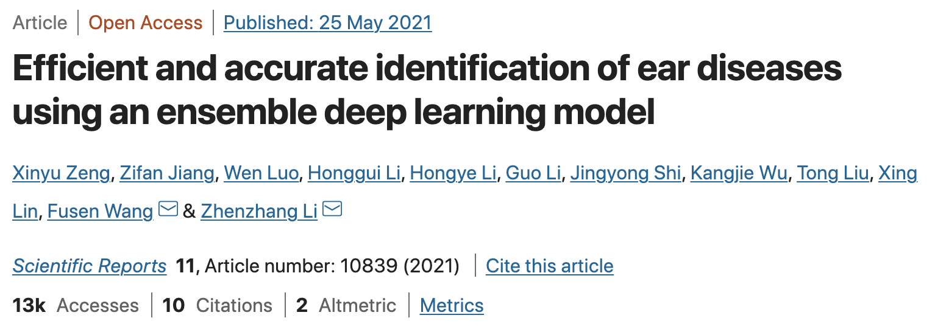
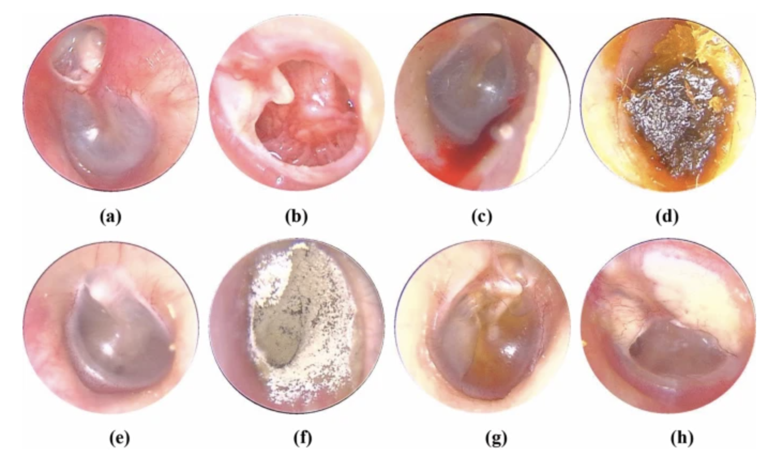
Prior Work
Classification | DenseNet
Zeng et al.: 95.59% accuracy for multiclass classification of ear diseases using ~20,500 images and pre-trained DenseNet architectures
X. Zeng, Z. Jiang, W. Luo, H. Li, H. Li, G. Li, J. Shi, K. Wu, T. Liu, X. Lin, F. Wang and Z. Li, “Efficient and accurate identification of ear diseases using an ensemble deep learning model,” Scientific Reports, 25-May-2021. [Online]. Available: https://www.nature.com/articles/s41598-021-90345-w. [Accessed: 4-Dec-2022].
Notes:
Presenter: Aidan
Existing research achieved 95% accuracy for a similar multiclass problem using an ensemble approach with pre-trained DenseNet architectures
They used a dataset of 20,500 images captured with an endoscope in similar but more consistent lighting conditions to those in our problem.

Slide 16
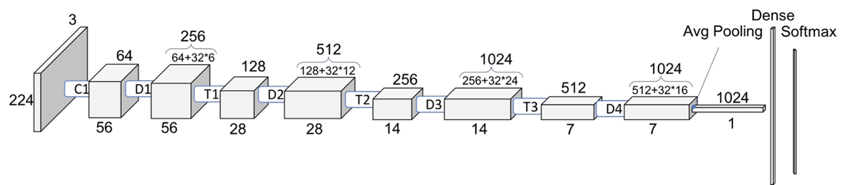
Design Decision
Classification | DenseNet
Notes:
Presenter: Aidan
Based on this research we implemented our own pre-trained DenseNet architecture but for OM/non-OM binary classification
For this model we downsized input images to 224 pixels and altered the final layer to have just two output classes, before tuning the learning rate, momentum, and batch size as hyperparameters
Training was performed using a 60/30/10 train/validation/test split with cross-entropy loss, and we tuned the learning rate, momentum, and batch size as hyperparameters

Slide 17
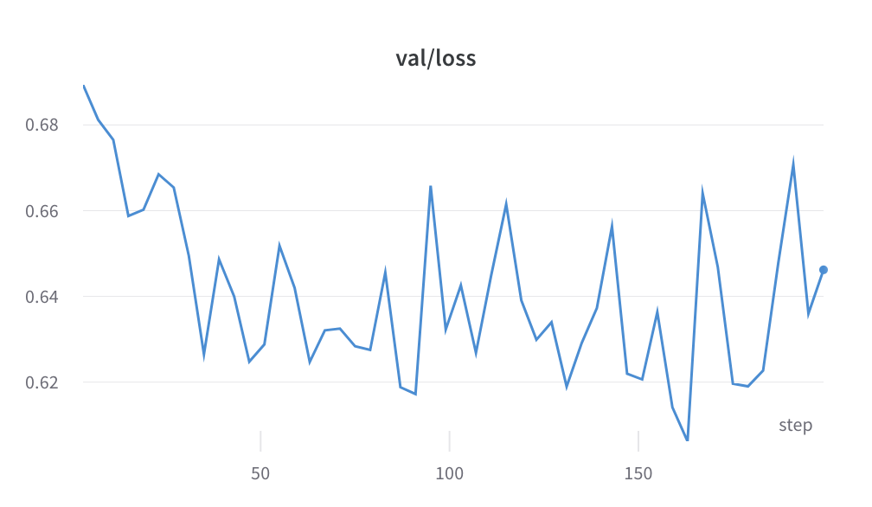
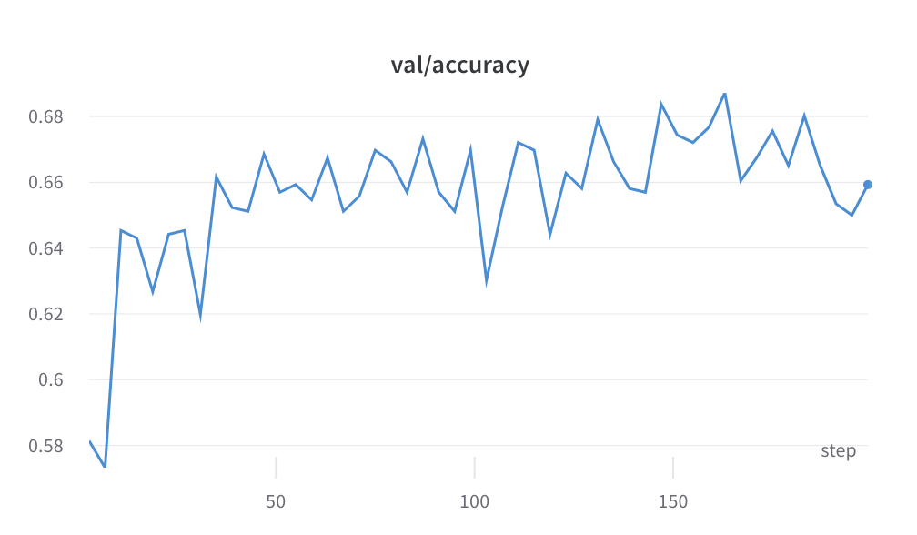
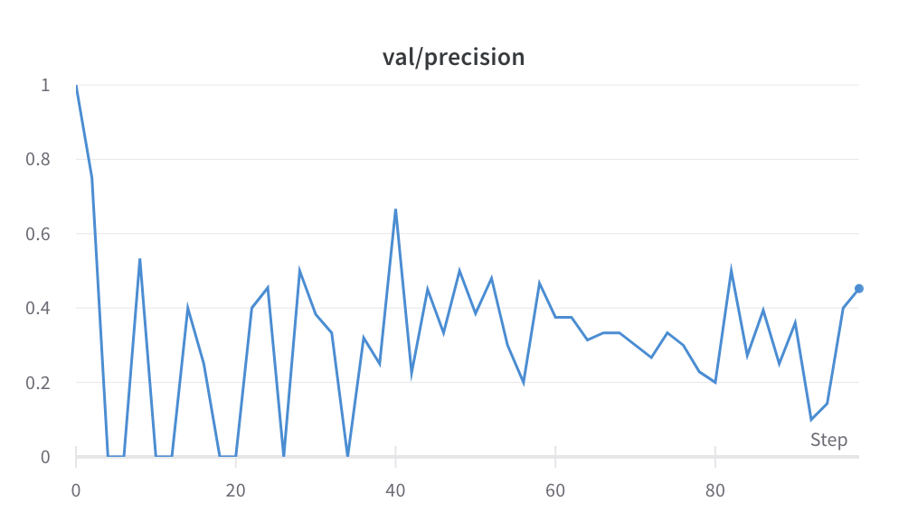
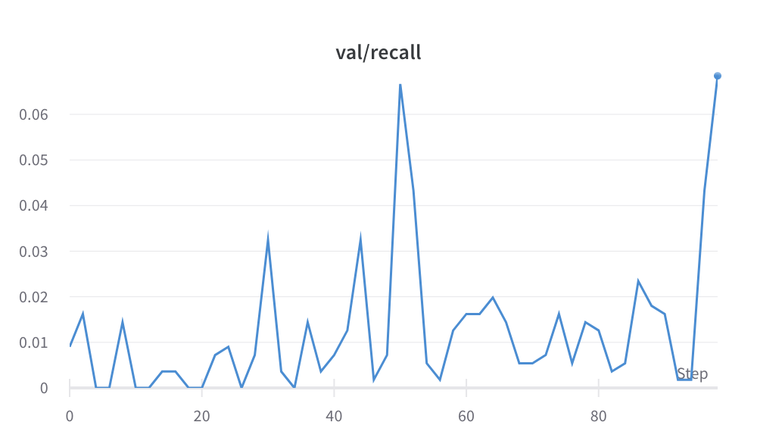
Final Architecture
Classification | DenseNet
honest-grass-3
Training Run | LR | Momentum | Batch Size | Val. Loss | Val. Precision | Val. Recall | Val. Accuracy
decent-paper-1 | 0.001 | 0.01 | 50 | 0.6065 | 0.2500 | 0.0521 | 0.6874
hardy-feather-2 | 0.001 | 0.05 | 50 | 0.5921 | 0.3864 | 0.4435 | 0.6833
honest-grass-3 | 0.001 | 0.01 | 20 | 0.6462 | 0.4523 | 0.6847 | 0.6593
northern-lake-6 | 0.01 | 0.01 | 10 | 0.6413 | 0.4412 | 0.1556 | 0.6362
fresh-bee-7 | 0.01 | 0.1 | 20 | 0.6523 | 0.2937 | 0.4231 | 0.6884
Test Results: Loss: 0.6877, Precision: 45.98%, Recall: 4.13%, Accuracy: 61.04%
Notes:
Presenter: Aidan
Our tuning results are presented on this slide. In validation, the honest-grass-3 run showed worse accuracy but better precision and recall than others. The loss curve pictured shows that DenseNet struggled to converge in just 50 epochs.
Unfortunately on test data this model showed only 4% recall, indicating unreliability when predicting for positive cases of OM.
The results of tuning with DenseNet are presented in the table on this slide. In validation, the honest-grass-3 run performed worse than others in terms of accuracy, but this is considered the best run since precision and recall are the most important metrics for the client. As seen in the loss curve, DenseNet generally showed difficulty converging in just 50 epochs.
On test data this model showed 61% accuracy but only 4% recall, indicating that it is unable to reliably predict for positive cases of OM.

Slide 18
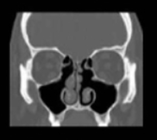
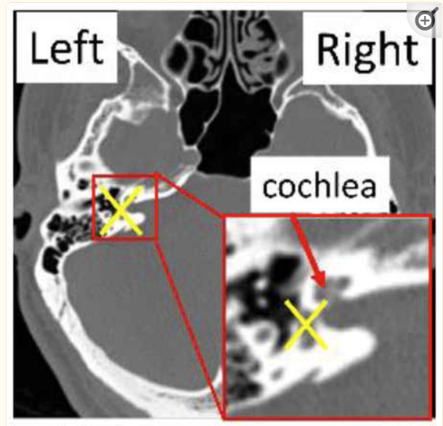
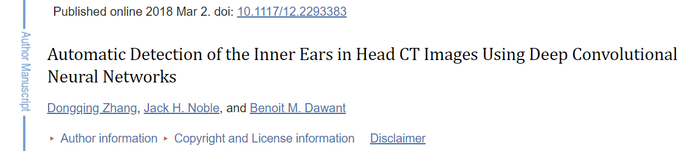
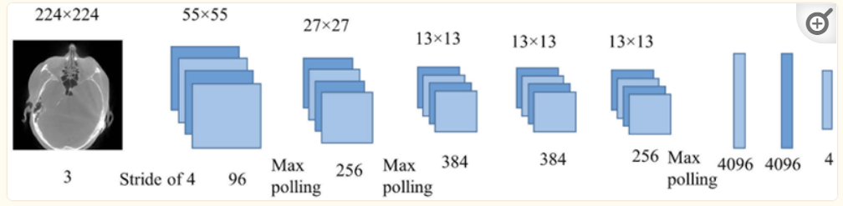
Prior Work
Classification | AlexNet
D. Zhang, J. H. Noble and B. M. Dawant, “Automatic Detection of the Inner Ears in Head CT Images Using Deep Convolutional Neural Networks,” National Library of Medicine, 19-Apr-2019. [Online]. Available: https://www.ncbi.nlm.nih.gov/pmc/articles/PMC6474381/. [Accessed: 4-Dec-2022].
Notes:
Presenter: Zahra
A literature review was conducted to find studies that used CNNs to classify medical images..
A relevant 2018 study used an AlexNet model, with an accuracy of 96% , to classify CT scans based on which ears were present [9].
Like our dataset, theirs was high noise.
Due to domain and dataset similarities,: we felt it was appropriate to test an AlexNet model

Slide 19
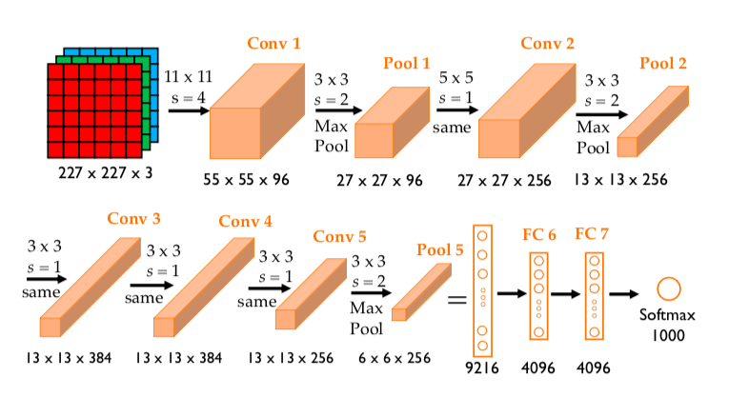
Design Decision
Classification | AlexNet
60/30/10: Train/Validation/Test Split
20 Epochs and Batch Size of 200
Cross Entropy Loss with SGD Optimization
First FC: 9216 to 2304 Neurons for Image Resize due to RAM constraints
A. H. Reynolds, “Large-scale image recognition: AlexNet,” Anh H. Reynolds, n.d. [Online]. Available: https://anhreynolds.com/blogs/alexnet.html. [Accessed: 4-Dec-2022].
Notes:
Presenter: Zahra
AlexNet Model structure is depicted on the screen. However, we had to change the NUMBER OF NEURONS in the Fully connected LAYER due to the resizing of our images due to RAM constraints on local machines.
With this model, we used a cross-entropy loss function with SGD optimization was used.
To determine specific model parameters, hyperparameter tuning was performed.
A standard train/validation/test split of 60/30/10 was used. This model was trained using 20 epochs and a batch size of 200.

Slide 20
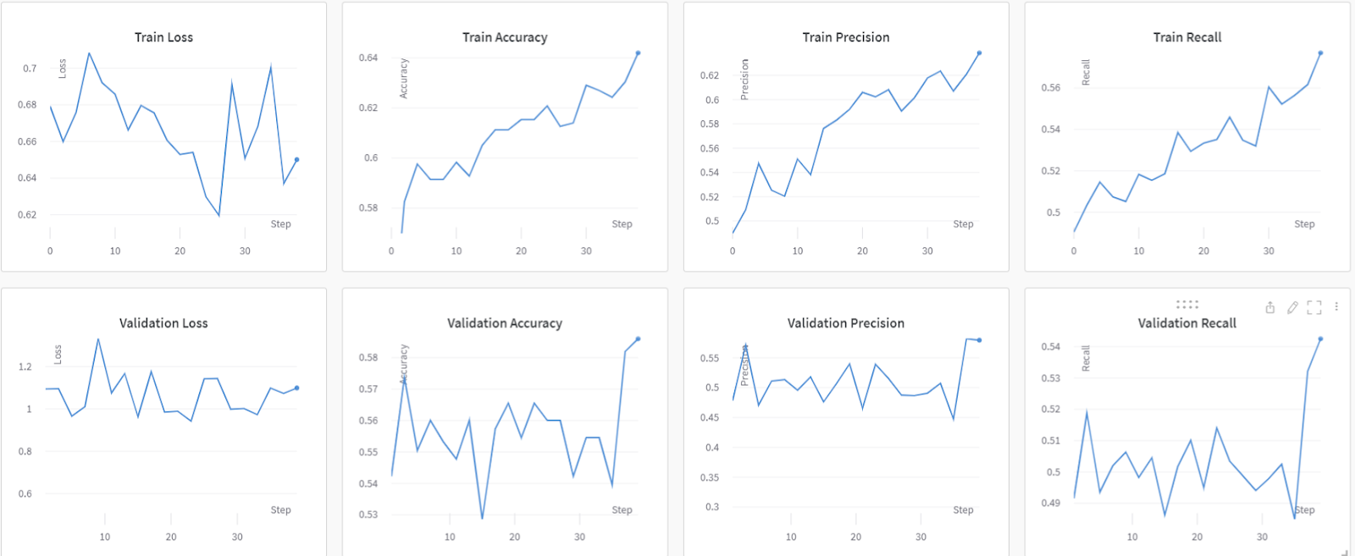
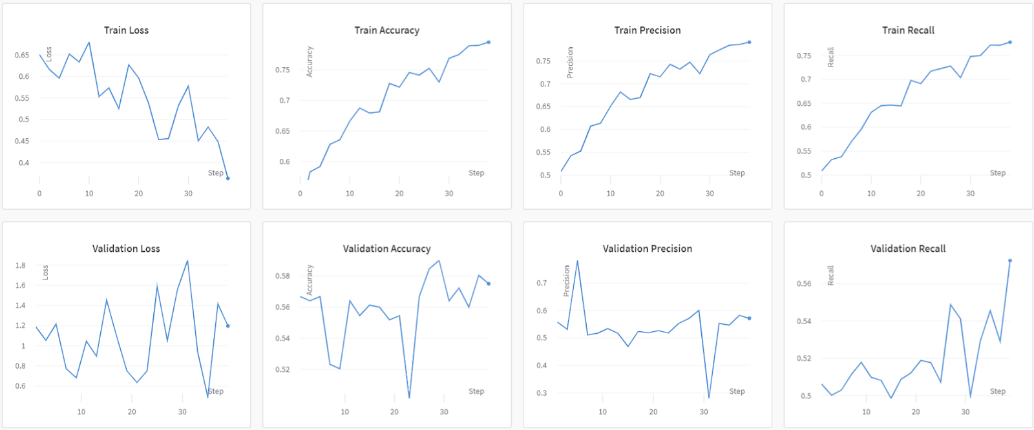
Final Architecture
Classification | AlexNet
Training Run | LR | Momentum | Weight Decay | Val. Loss | Val. Precision | Val. Recall | Val. Accuracy
dashing-dew-3 | 0.01 | 0.01 | 0.05 | 1.668 | 0.5476 | 0.5347 | 0.5683
bright-field-4 | 0.001 | 0.09 | 0.005 | 1.286 | 0.5194 | 0.5053 | 0.5601
astral-aardvark-7 | 0.02 | 0.01 | 0.06 | 1.187 | 0.5207 | 0.5134 | 0.5519
youthful-breeze-9 | 0.001 | 0.1 | 0.006 | 1.099 | 0.5796 | 0.5426 | 0.5861
dainty-glade-11 | 0.01 | 0.1 | 0.07 | 1.196 | 0.5715 | 0.5725 | 0.5751
Youthful-Breeze-9
Test Results: Loss: 0.3617, Precision: 51.45%, Recall: 51.58%, Accuracy: 52.05%
Dainty-Glade-11
Notes:
Presenter: Zahra
The LR, momentum and weight decay were treated as hyperparameters.
Results are presented in the table.
The corresponding graphs for the highest-performing model, dainty-glade-11, are presented in Figure 10. Although it appears that training run youthful-breeze-9 had the highest performance, its loss curve showed no evidence of convergence over time (see Appendix C.a.2.iv). See Appendix C.a.2 for the remaining results and graphs.

Slide 21
AlexNet vs. DenseNet
Classification Model
Essential metrics: High precision and recall required for FDA approval of the product
DenseNet: Better performing accuracy, significantly lower precision and recall
Best performing model overall: AlexNet
Architecture | Loss | Precision | Recall | Accuracy
DenseNet | 0.6877 | 0.4598 | 0.0413 | 0.6104
AlexNet | 0.3617 | 0.5145 | 0.5158 | 0.5205
Notes:
Presenter: Aidan
In comparing early models, we looked for higher precision and recall based on the need for FDA approval
Despite DenseNet showing better accuracy in testing, its low recall makes the network unsuitable for our use case.
Because of this requirement we moved forward with AlexNet as the best performing model for binary classification

Slide 22
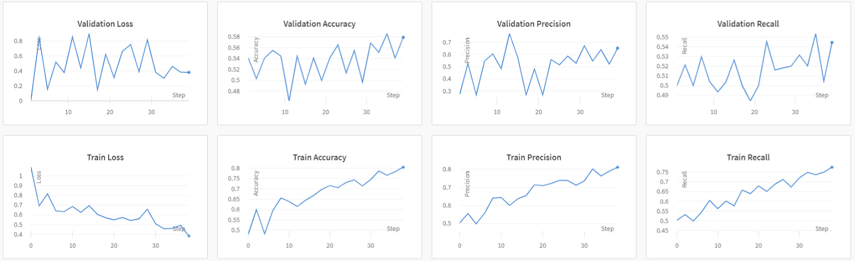
Less is More: AlexNet On Dataset C
Classification Model
Training Run | LR | Momentum | Weight Decay | Val. Loss | Val. Precision | Val. Recall | Val. Accuracy
quiet-jazz-2 | 0.01 | 0.1 | 0.07 | 0.8353 | 0.521 | 0.521 | 0.524
avid-grass-5 | 0.01 | 0.02 | 0.045 | 0.6131 | 0.546 | 0.5331 | 0.5548
trim-energy-6 | 0.01 | 0.02 | 0.045 | 0.1065 | 0.2705 | 0.5 | 0.5411
fluent-firefly-8 | 0.01 | 0.03 | 0.045 | 0.3804 | 0.6521 | 0.5444 | 0.5788
Test Results: Loss: 0.3138, Accuracy: 71.43%, Recall: 57.44%, Precision: 69.29%
Fluent-Firefly-9
Notes:
Zahra
Based on the success of prior work, we hypothesized that running the best-performing architecture on the more diagnosable images would yield higher results.
We thus moved forward by testing the AlexNet model against the smaller, filtered dataset using the same tuning and methodology previously presented. Training results are presented in the graph
On all permutations of the model, training run fluent-firefly-8 had the best overall performance and was tested on the test dataset.
It had a test loss of 0.3138, and had accuracy, precision and recall values of 0.7143, 0.6929 and 0.5744 respectively.

Slide 23



Discussion: Data Processing
Infrastructure Limits
Dataset Noise
Dataset Size
Notes:
Presenter: Jay
Our data-processing got us through the project, but we identified several areas for improvement.
Firstly, as mentioned by Tian, not having access to our ideal labeling system made us less flexible.
Second, our dataset was noisy, and impossible to filter without manual labeling and domain expertise.
Finally, the limited labeling we could do, reduced our dataset size by almost 95%.

Slide 24
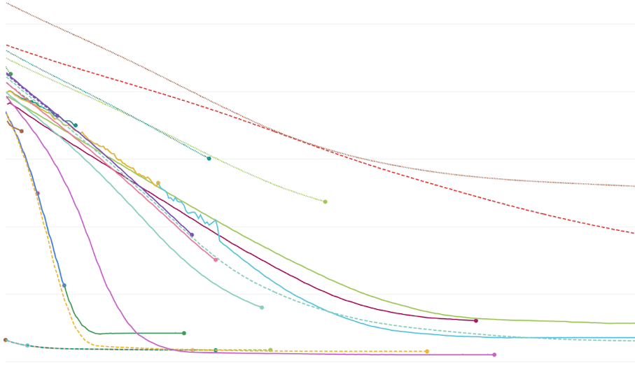
Discussion: Object Detection
Bias Detection
Loss Floor
Notes:
Presenter: Jay
In our object detection model, one challenge we found was quantifying bias.
For example, how robust is our model to the underlying orientation, glare, scale, etc.
Given the nature of image-data, quantifying these is impossible without significant labeling.
Another interesting result is that despite major architectural changes, multiple models hit the same hard-floor on loss.
We’re very interested in seeing how this responds to more data.

Slide 25
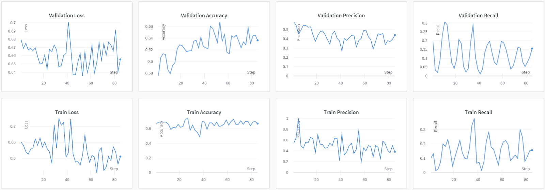

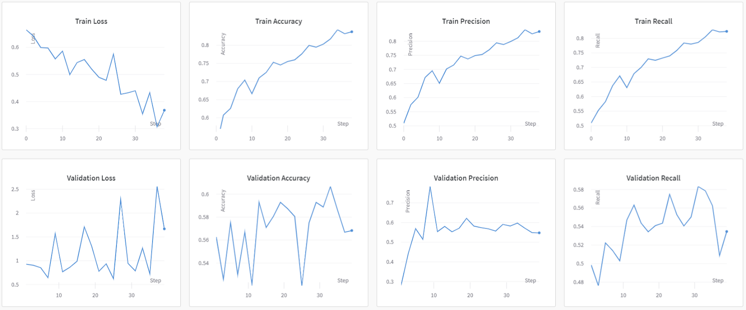


Discussion: Classification
DenseNet
Architecture | Loss | Precision | Recall | Accuracy
DenseNet | 0.6877 | 0.4598 | 0.0413 | 0.6104
AlexNet | 0.3617 | 0.5145 | 0.5158 | 0.5205
DenseNet: No Evidence of Learning
AlexNet: Dataset B
AlexNet able to Predict OM, DenseNet Not
Proof of Concept Model Most Successful
Notes:
Presenter: Aidan
(Discussion)
Despite hyperparameter tuning, early classification models did not achieve our objective.
While DenseNet fell short in terms of precision and especially recall, AlexNet showed a 19% increase in test accuracy and improved recall and precision after training on the smaller, filtered dataset
It's not yet usable in production, but these improvements suggest that AlexNet could be successful with better data.
Despite hyperparameter tuning, early classification models did not achieve our objective.
While DenseNet fell short in terms of precision and especially recall, possibly because our dataset was too small and varied too greatly from that used for pretraining.
On the other hand, especially after training on the smaller, filtered dataset, AlexNet showed a 19% increase in test accuracy alongside improved recall and precision. While not yet usable in production, these improvements suggest learning and that AlexNet could be further improved with better data.

Slide 26
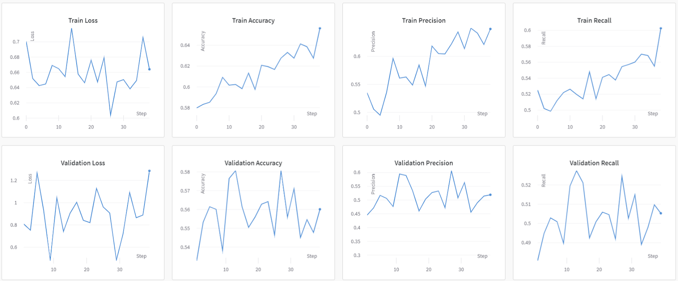


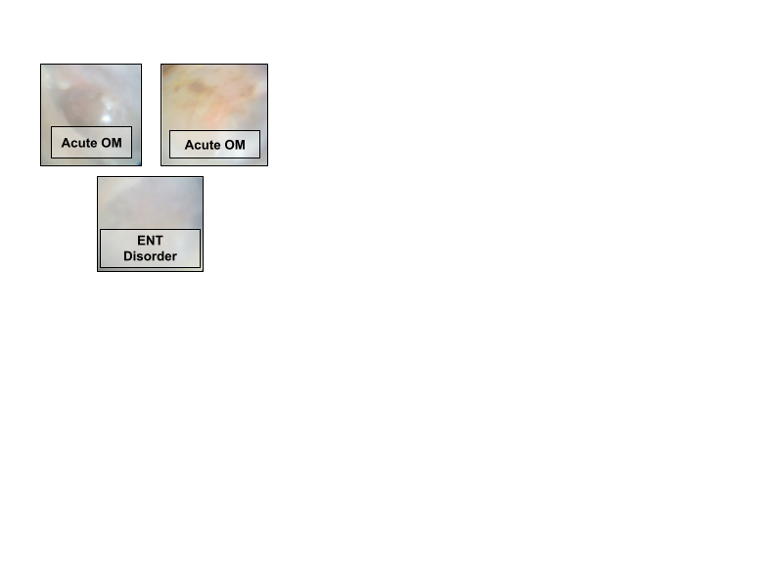

Discussion: Limitations
AlexNet Hyperparameter Tuning
RAM Constraints Local Machines
Limited Subset of Diagnosable Data
No Symptom Labels
Notes:
Presenter: Zahra
As addressed: Potential issues with RAM: we had to resize images which may have further impacted their quality. In addition, as presented in the graphs, it would have been mode ideal to test different number of epochs and batch size, although we
Although we were able to demonstrate success with OD model, we ultimately believe our CM results are indicative of training on insufficient data.

Slide 27
Discussion Recap
Data Processing and Object Detection
NOVEL APPROACHES
LIMITATIONS FROM dATASET
CLASSIFICATION MODEL
Discussion
Final Presentation
Notes:
Presenter: Zahra
Data Processing and Object Detection: Successful Object detection model has demonstrated beyond random chance that learning is feasible with our architecture.
Classification Model: Unsuccessful
However, we would propose the usage of the AlexNet model as it was more successful.
Much of the prior work we explored was conducted with datasets more suited for diagnostic classification (with diagnosable images, symptom labels, etc.), and thus performed better in all comparable metrics.
However, as demonstrated by the development of an AlexNet model on the filtered dataset, we anticipate that as more suitable data with symptom labels are collected, model performance will improve significantly.
Literature Review: Suggested that both suggested models are novel approaches to our task. However, much of the prior work for classification implemented a DenseNet model, we also recommend re-testing the DenseNet model with sufficient data.

Slide 28
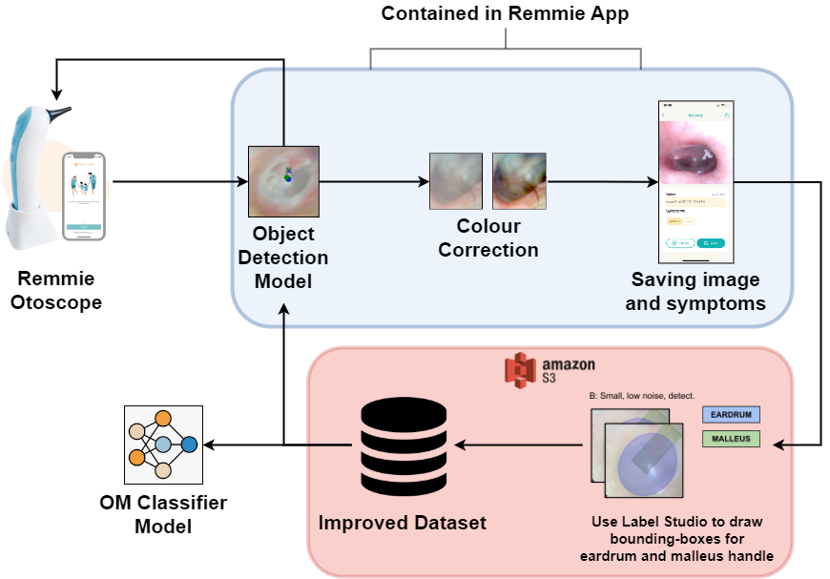


Implementation: Data Processing & Labelling
/
Notes:
Presenter: Tian
To utilize the models we propose, Remmie should train them further with more labelled data to improve their precision and recall.
Remmie can set up Label Studio on their server for manual labelling of their dataset.
Alternatively, Remmie can use third party labelling services such as Scale AI or Amazon Mechanical Turk.

Slide 29


Implementation: Models
​Object Detection Model:​
ResNet-50, 20 MB
+
Classification Model:​
AlexNet, 200 MB
Remmie
PyTorch Mobile
Notes:
Presenter: Tian
Once our model reached the required precision and recall, Remmie can deploy them as components of their mobile app, using platforms such as PyTorch Mobile.
As our models are pretty small in size, they would be able to run on modern mobile devices easily.

Slide 30
Thank you

